Slide 1
Entity ※
Direction of time
a
Entity A
Entity B
b
Entity C
Entity D
T1
T2

Slide 2
Entity A
Entity A
Event ※
y-axis
Entity B
Entity C
Entity C
Entity D
Entity D
Entity B
Entity E
Entity E
a
b
x-axis

Slide 3
Sentence
NP
V
VP
Adv
to
Mary
wants
Part
V
NP
today.
eat
spaghetti

Slide 4
a
HED
SBV
VOB
CMP
WP
ROOT
PROPN
VERB
NOUN
NOUN
PUNCT
Tom
eats
oranges
today
.
mPunc
b
Root
Tmod
Agt
Pat
ROOT
PROPN
VERB
NOUN
NOUN
PUNCT
Tom
eats
oranges
today
.

Slide 5
T_{e}
T
t
d_{e,t,h}
H_{e}
H
a
c
b

Slide 6

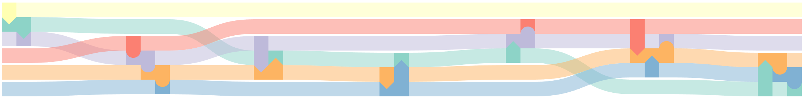

Slide 7
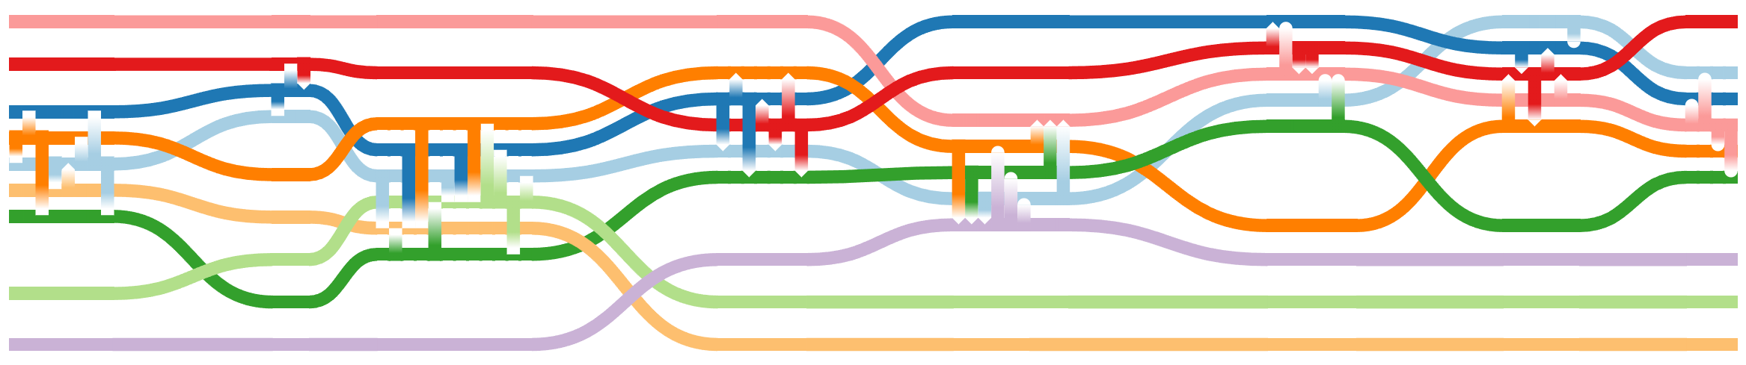
Aslan
White Witch
Edmund Pevensie
Peter Pevensie
Lucy Pevensie
Mr. Tumnus
Susan Pevensie
Mr. and Mrs. Beaver
Father Christmas

Slide 8

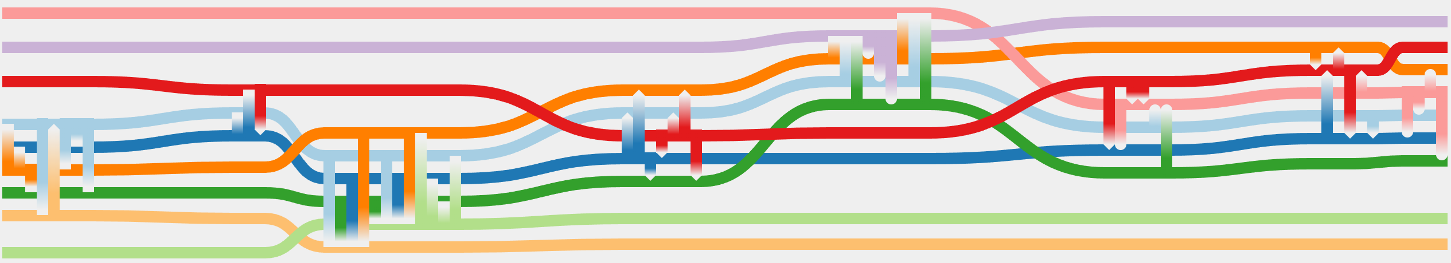
Live text commentary
SPO triples
HDRs
HDR1、HDR2
Textual synopsis of movies
Timeline
SDRs
SDR1、SDR2
CDRs
CDR1、CDR2
Events
Design requirements
&
Optimization model
Storyline layout
Data Source
Data Processing

Slide 9
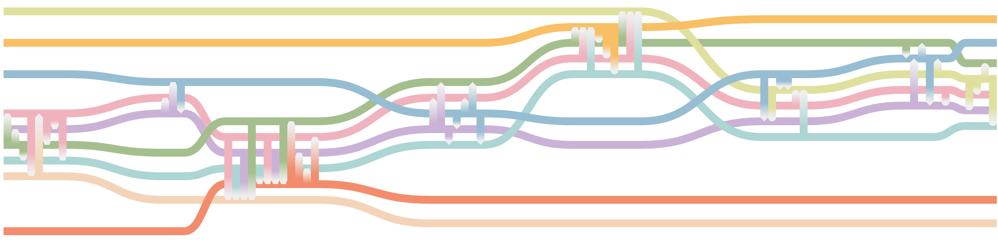

Aslan
Father Christmas
White Witch
Lucy Pevensie
Edmund Pevensie
Peter Pevensie
Susan Pevensie
Mr. Tumnus
Mr. and Mrs. Beaver

Slide 10
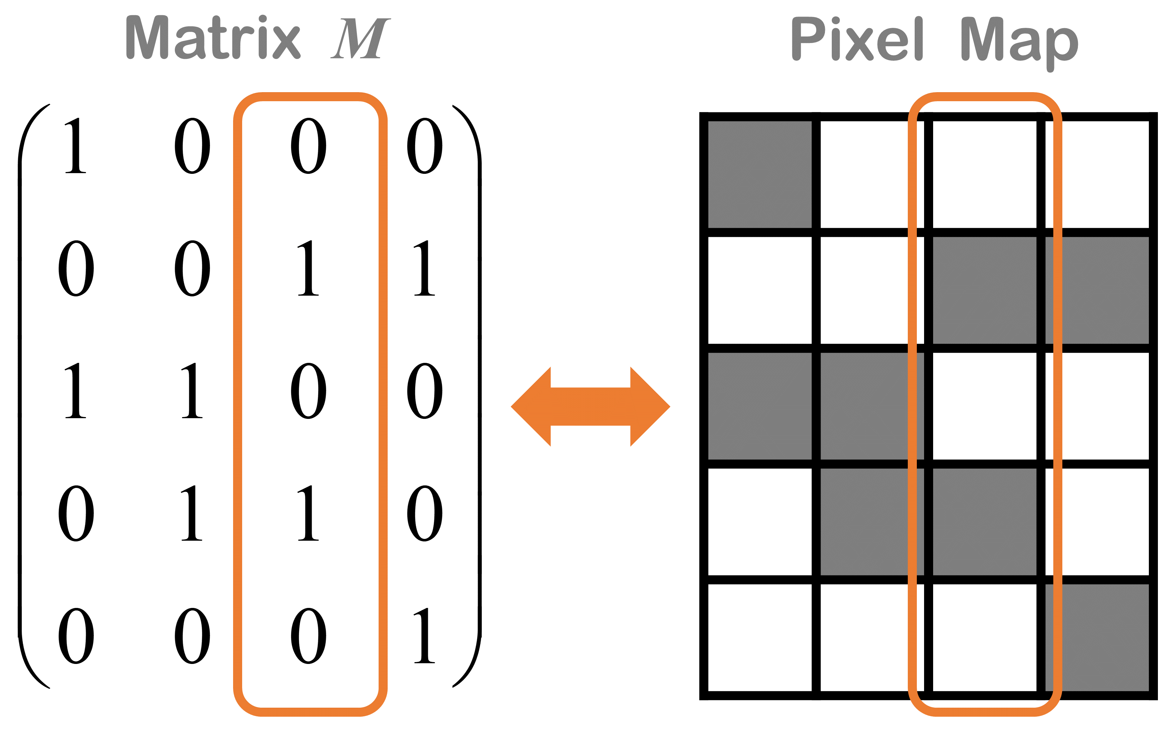
y-axis
Entity A
Entity A
Entity B
Entity B
Entity C
Entity C
Entity D
Entity D
Entity E
Entity E
x-axis
Matrix M
Pixel map

Slide 11
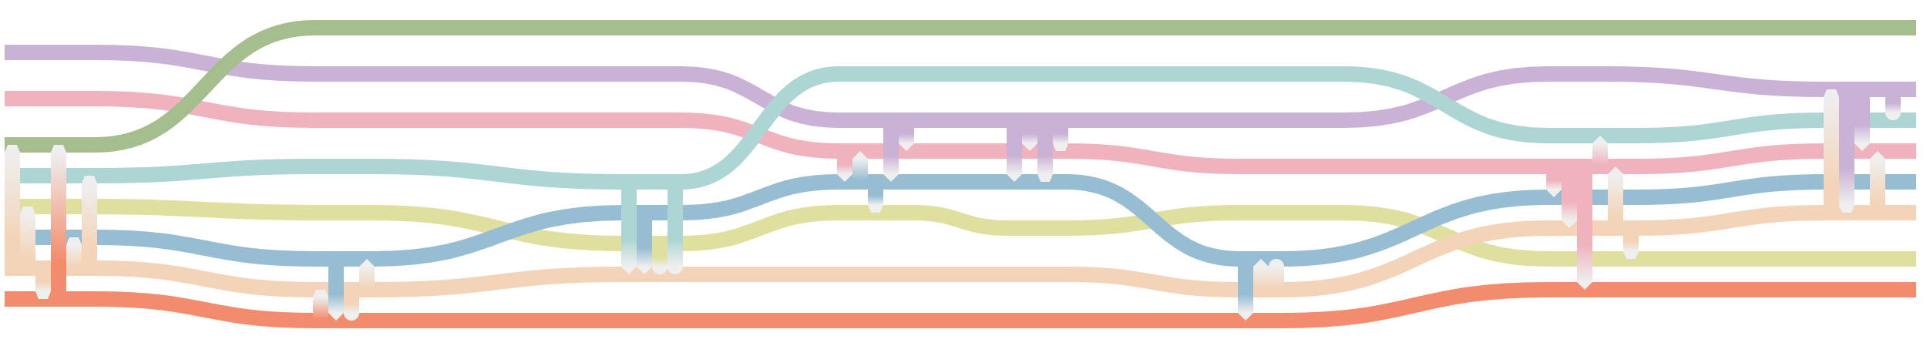
Police Officer
The Syndicate
Uncle Bill Ma
Nancy
Danny
The Gang
Ma Hon Keung
Elaine

Slide 12
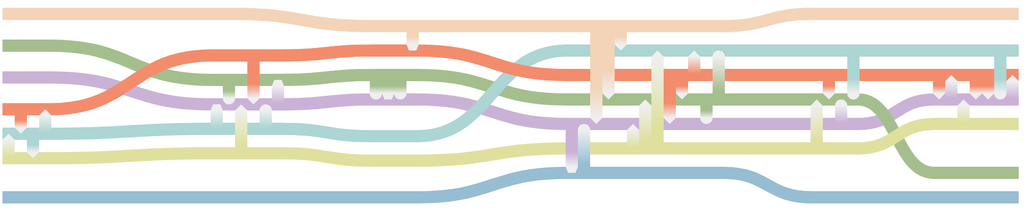
Cypher
Morpheus
Neo
Nancy
Danny
The Gang
Elaine

